Slide 1

Bringing Explainable AI into Business Applications

Slide 2

Speaker Profile
Shipra Jain
SAP Data-Science Expert
AI Foundation
SAP Labs, Bangalore

Slide 3
Introduction
Problem Statement
The new paradigm of building AI based applications(increasingly black-box in nature) brings in more challenges for SAP in terms of explaining the ML outcomes from the business context.
Therefore, explaining the results of ML algorithms with local and global explanations that can be leveraged across the business applications is becoming increasingly important.

Slide 4
Introduction
Solution Overview
Developing a Performant, Model agnostic Explainable AI (XAI) framework/ library that can explain the prediction of ML algorithms on different kinds of datasets and provide business friendly and interpretable explanations and insights into the model

Slide 5
How Explainable AI can help
Establishing “Trust” on AI Solution:
Decide if one should trust a “prediction”
Understand “Model Behavior” and choosing between models
Identify if a Model is forming Spurious Co-relations and can’t be trusted
Improve Untrustworthy Model
Other Advantages:
Compliance w.r.t. Government Regulations, Audits and GDPR
Enhance “Fairness” in AI by explaining Model (or) Data bias
Enable Informed Human Decision Making

Slide 6
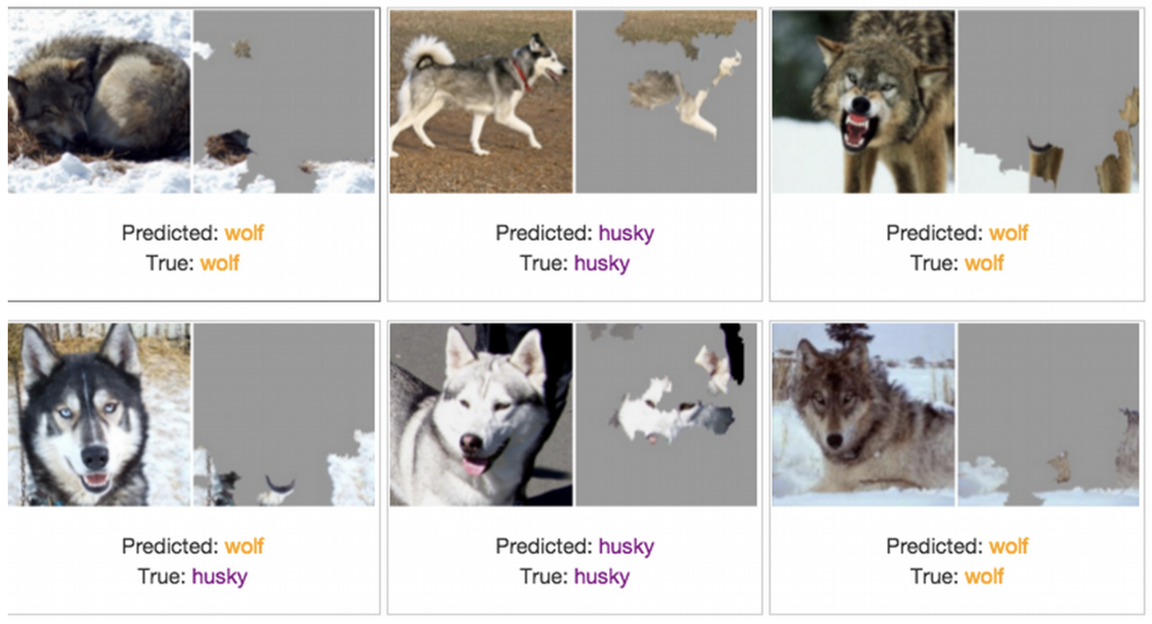
Image Classification Identifying Untrustworthy model and why

Slide 7
Challenge
Link: https://sap-code.hackerearth.com/challenges/hackathon/sap-code/custom-tab/explainable-ai/#Explainable%20AI
Dataset: Training Data
The dataset given consists of categorical, numerical and text fields. The XAI framework should be able to explain the classification by these models : a Linear SVC Model, a Deep Neural Network with 3+ hidden layers and a CNN along with developing a performant XAI framework. Ability to explain more complex models such as LSTM, RNN and Attention Based models is a bonus.
Evaluation Criteria: XAI Submission Document

Slide 8
Expected Outcome
The XAI model should
Basic
Work for the different kind of classification models given (Model Agnostic) and different kinds of datasets. The datasets can contain text, numerical and categorical fields. If the algorithm has various flavours or add-ons, depending on dataset type or classification algorithm, that is okay.
Generate explanations which are understandable for end-users and can help in informed decision making by increasing trust of the generated outcomes and bridge gap between predictions and expectations.
Generate both global and local explanations.
The solution should be able to handle text embedding techniques such as: Bag of Words.
Intermediate
Explanations need to be context-specific to the use case.
Understand the problem deep enough to generate explanations that are as close to explanations by a human. The explanations should be in natural language and should be understandable by business users.
Performance considerations for volume of data – Time taken to generate explanations should add least overhead on performance.
Multi-level explanations - granular level of explanations that is well represented in a usable form. Eg: flow from high level explanations to low level explanations which users can easily navigate and understand.
A content specific explainable framework/library that can be integrated easily with business applications.
Technical approach using the open sources, cloud, k8s etc that could help build the solution faster.
The solution should be able to handle text embedding techniques such as: Bag of Words + Word Embeddings (eg: Word2Vec).

Slide 9
Expected Outcome (Contd.)
Advanced
Model agnostic way of generating explanations for all supervised learning problems (Image Classification, LSTM models, Attention Based models etc).
Visualization framework which can help depict the explanations and can be integrated with cloud solutions.
Start with predictions -> Generate explanations -> Assess generated explanations -> Convert into meaningful explanations -> Visual representation of explanations.
The solution should be able to handle text embedding techniques such as: Bag of Words + Word Embeddings + Sentence Embeddings (eg: Universal Sentence Encoder).

Slide 10
Evaluation Criteria
Code Quality, Technology Used, and Architecture Creative and innovative, usage of technologies Use of emerging technologies Quality of code Use of external libraries in code Level of coding Beautified and well-maintained code Algorithms, APIs, Creativity, Logic, Framework, and Data Management
Design Use of current technologies and open-source frameworks (ex- Tensorflow, FastAI) and pre-trained models (ex- BERT, etc.) Interface and design of APIs for analytical insights Data and metadata management and scalability for higher volumes of data
Overall Usability Overall functionality of the submission Use of dataset (external/provisioned) which would make sense Added efforts/features/value to the overall work (video, presentation, analytics, etc.). Embracing innovation/idea/task in mind Lesser bugs Documentation, Collaborative tools and ease of solution adaptability
Implementation Comprehensiveness of the solution in terms of functionality and working given the idea/concept Measure of solution in technical terms such as accuracy, adaptive mechanisms, model performance etc. Ease at which the solution can be implemented in the field

Slide 11
Q & A

Slide 12
THANK YOU
ALL THE BEST

